Slide 1
Laptop Price Analysis
Team Member:
Hồ Ngọc Ánh - 20214877
Hoàng Thành Đạt - 20214889
Trịnh Hoàng Giang - 20214893
Vũ Lâm Anh - 20214876
Lăng Văn Quý - 20214928

Slide 2
Group Members
Trịnh Hoàng Giang 20214893
Hoàng Thành Đạt 20214889
Vũ Lâm Anh 20214876
Hồ Ngọc Ánh 20214877
Lăng Văn Quý 20214928

Slide 3
Introduction
The goal of this project is to develop an accurate model to predict laptop price. Then, it can help sellers can maximize their sales or buyers can forecast the price and use that information to make purchase decisions.
The general step of our project :
1. Collect the data
2. Clean, preprocess and analyze data
3. Use data to build model

Slide 4



Collect the data
In this project, one of the most well-known e-commerce sites, Amazon, will be mined for information about laptops
Specific laptop webpage

Slide 5
Collect the data
AMAZON WEBSITE
Spider
Downloader Middleware
8
1
7
5
4
9
Engine
Downloader
Laptop.csv
6
2
3
4.5
Scheduler
REQUEST
REQUEST
REQUEST
LIFO
Architecture component and data flow inside system - Simplified version of scrapy architecture in source: Architecture overview — Scrapy 2.11.0 documentation

Slide 6

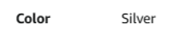
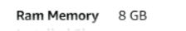
Collect the data
We use CSS Selector to extract the attribute from content of the website.
Specific laptop webpage

Slide 7
Collected attribute
Attribute | Data type
Brand | Categorical
Model | Categorical
Screen size | Discrete numerical
Screen resolution | Categorical
CPU | Categorical
CPU speed | Continuous numerical
Ram | Discrete numerical
Rom | Discrete numerical
GPU | Categorical
GPU description | Categorical
Operating System | Categorical
Weight | Continuous numerical
Color | Categorical
No_reviews | Continuous numerical
Ratings | Continuous numerical
Price | Continuous numerical

Slide 8
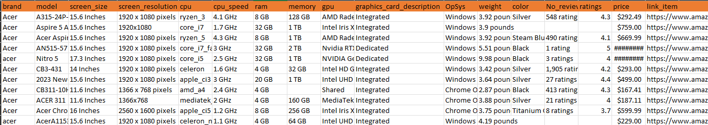
Output data

Slide 9
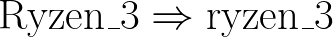
Data Preprocessing
Drop irrelevant attributes.
Lowercase all values.
Remove missing values
Drop duplicated rows
Convert data into appropriated units and remove unit.

Slide 10

Data Preprocessing
For categtorical attributes
Combine string values having same meanings but different representations into one.
Substitute "other" for values with small number of instances.
Split "screen_resolution" into:
Pixel per Inch(PPI): Number of diagonal pixels over screen size​
Screen Resolution: Product of width pixels and height pixels(Total pixels)

Slide 11
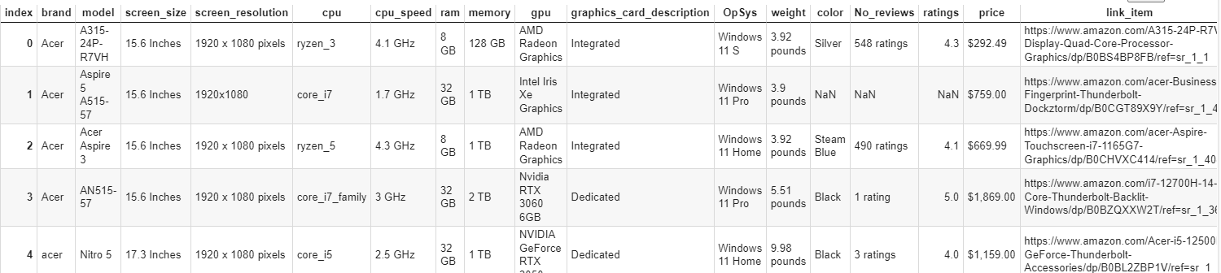
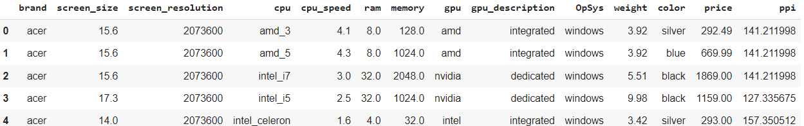
Data Preprocessing
Raw Data(5559 instances)
Preprocessed Data(2435 instances)

Slide 12
Exploratary Data Analysis
Outlier Detection and Removal
Use box plot and scatter plot to visualize and detect outliers.
Values that not belong to (mean-3*std,mean+3*std) are probably outliers.

Slide 13
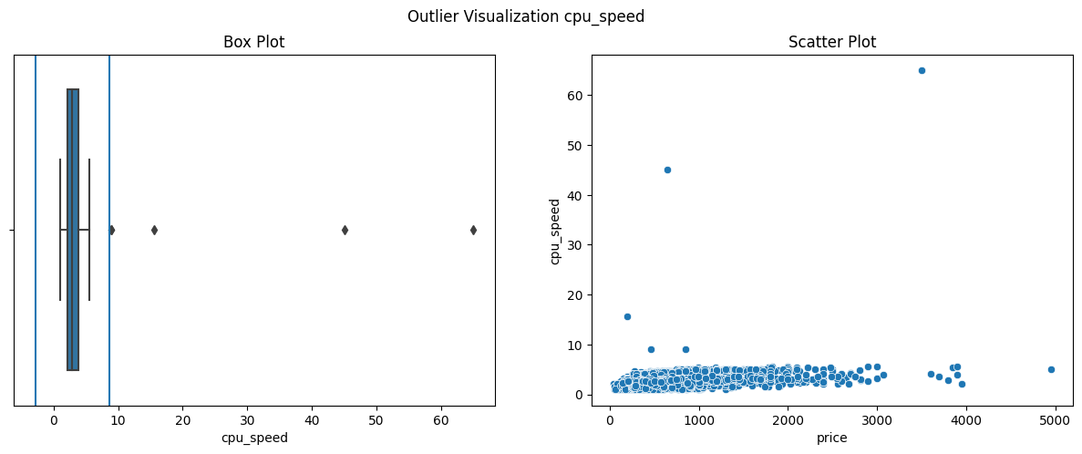
Exploratary Data Analysis
Outlier Detection and Removal

Slide 14
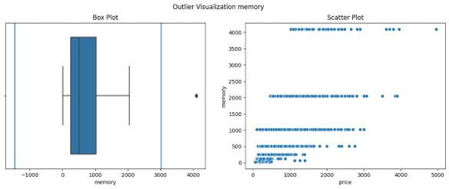
Exploratary Data Analysis
Outlier Detection and Removal

Slide 15
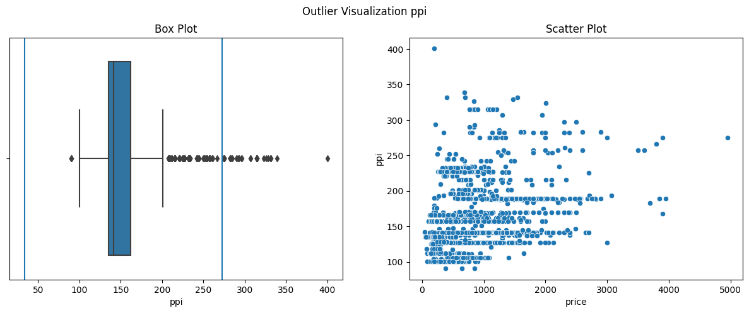
Exploratary Data Analysis
Outlier Detection and Removal

Slide 16
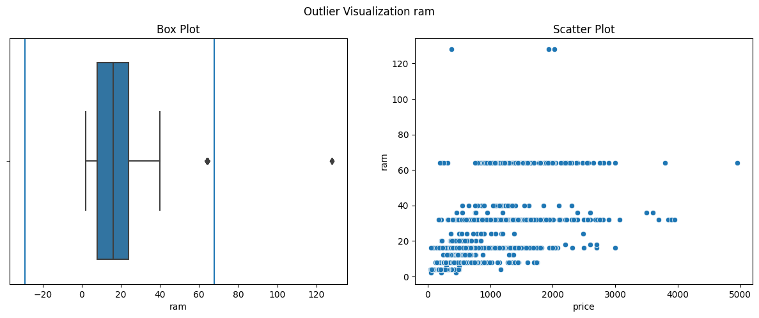
Exploratary Data Analysis
Outlier Detection and Removal

Slide 17
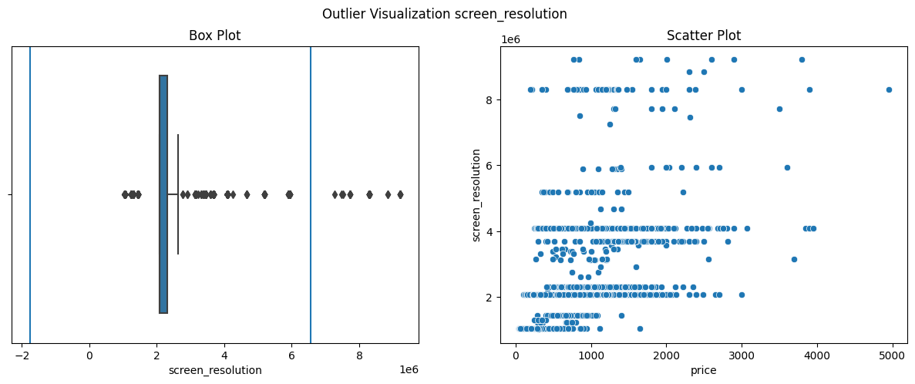
Exploratary Data Analysis
Outlier Detection and Removal

Slide 18
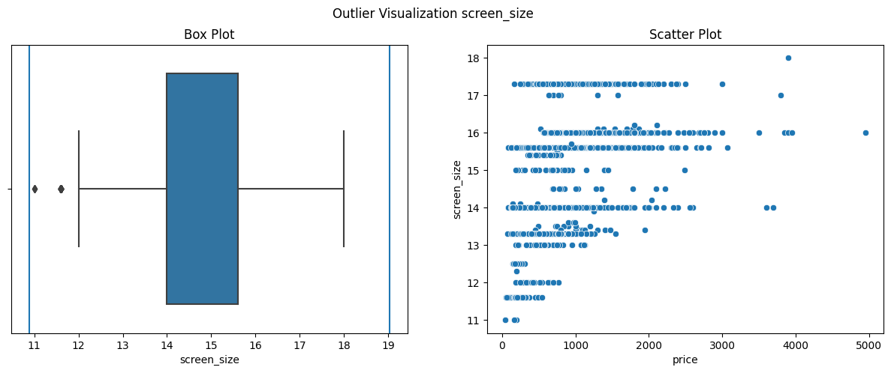
Exploratary Data Analysis
Outlier Detection and Removal

Slide 19
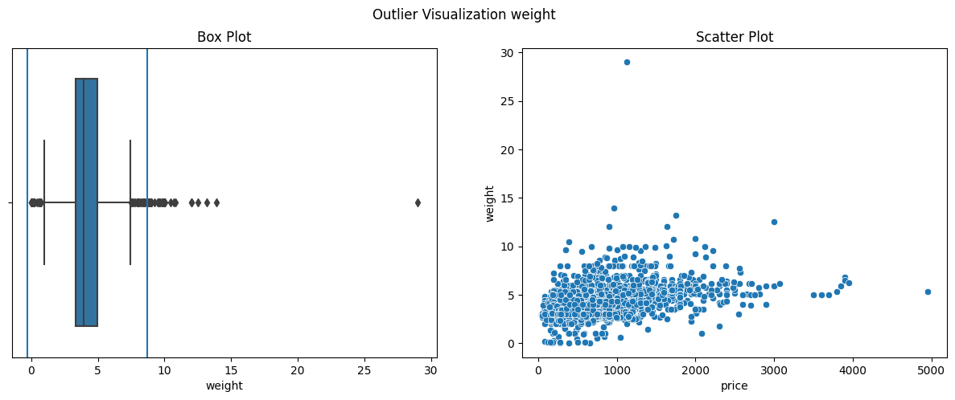
Exploratary Data Analysis
Outlier Detection and Removal

Slide 20
Exploratary Data Analysis
Outlier Detection and Removal

Slide 21
Exploratary Data Analysis
Outlier Detection and Removal
Conclusion: we eliminate rows with CPU speed>40, RAM>80, PPI>350 and weight>15 based on these presumptions
After removing outliers, data size reduce to 2427.

Slide 22
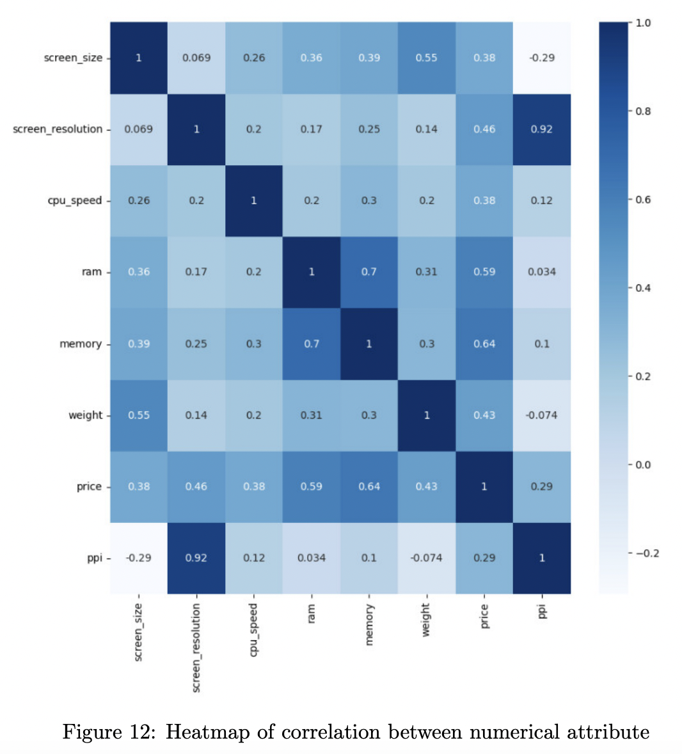
Exploratary Data Analysis
Data Visualization
All numerical attributes show a positive correlation with price (0.29 to 0.64).
RAM size and ROM size have large positive correlation.
Screen size is dependent on weight.

Slide 23
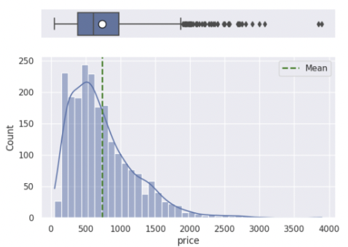
Exploratary Data Analysis
Data Visualization
Price has many outliers beyond the 75% quantiles and its distribution is skewed right.
The most common price lies between about 400-600 dollars.

Slide 24
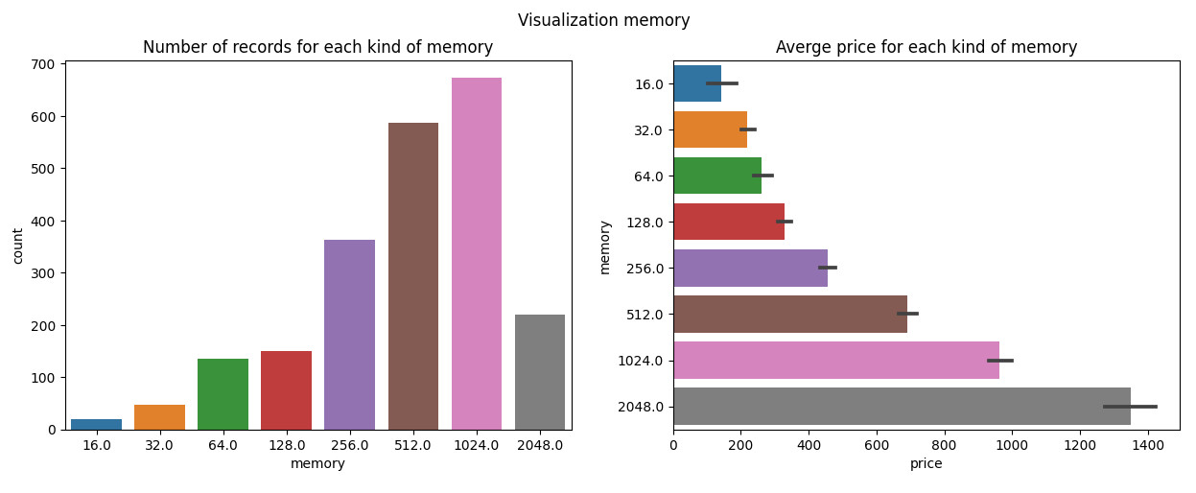
Exploratary Data Analysis
Data Visualization
Regarding ROM categories, the popular types of ROM was from 256 to 1024 GB.
Regarding the ROM prices, the prices increased correlating to the size of ROM.
Notes:
We observe a very large concentration of records in the memory range from 256 GB to 2048 GB. Conversely, the number of records with smaller memory is much less. This is suitable because it will meet the needs of modern computers, helping people store more.
A parallel observation can be made when examining the relationship between memory size and laptop prices. Similar with RAM size, we can see very clearly with ROM-Average Price graph, As the memory size increases, there is a discernible upward trend in laptop prices., when memory size increases the laptop price is also increasing.

Slide 25
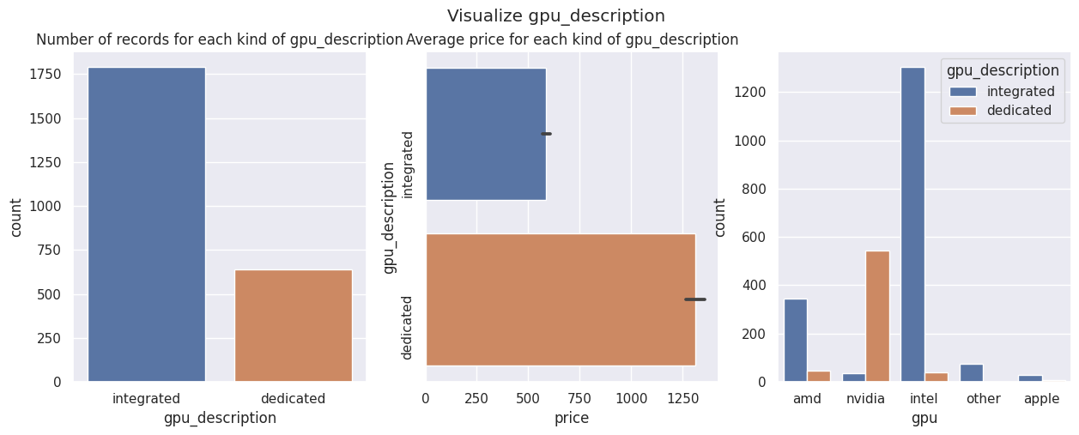
Exploratary Data Analysis
Data Visualization
Average price for dedicated GPU laptops is higher than integrated GPU laptops.
Most of GPU produced by NVIDIA are dedicated while GPU from other brands are majorly integrated.
Notes:
We find a notable distinction between laptops equipped with dedicated GPU and those featuring integrated GPU. Specifically, the number of laptops with dedicated GPU appears nearly one-third of the total, indicating a prevalence of integrated graphics solutions in the market. And laptops equipped with dedicated GPU cost significantly more than integrated GPU.
The observed distribution highlights a trade-off in the market, where users opting for dedicated GPU are likely to prioritize enhanced graphics performance, often associated with more demanding tasks such as gaming or graphic design. Conversely, laptops with integrated GPU offer a cost-effective solution for users with less graphics-intensive needs.

Slide 26
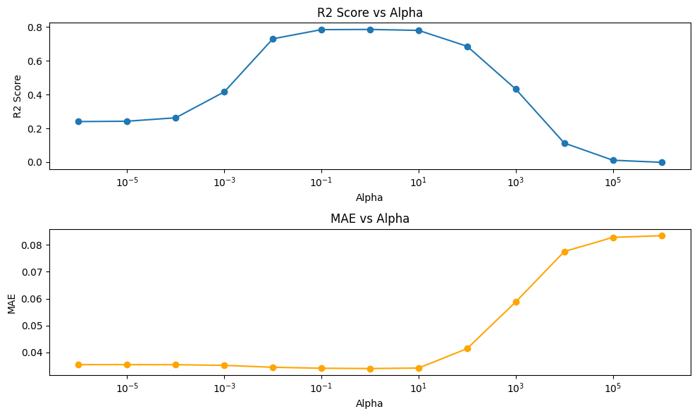
Modeling
Linear Model
Ridge parameter: Alpha = 1

Slide 27
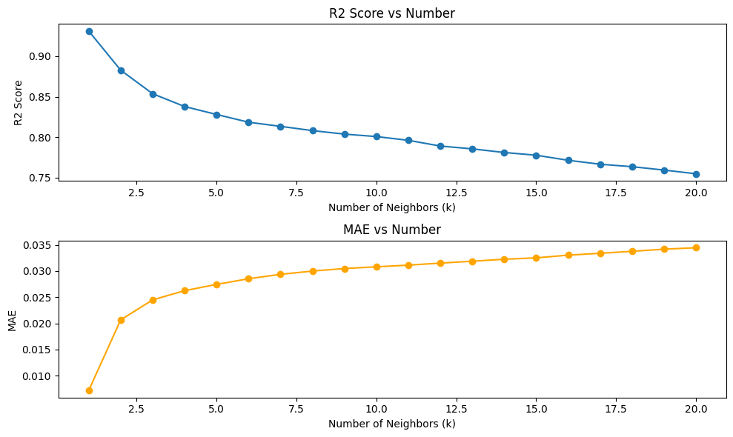
Modeling
KNN
KNN parameter: K = 1
Notes:
Distance metric: Euclidean

Slide 28
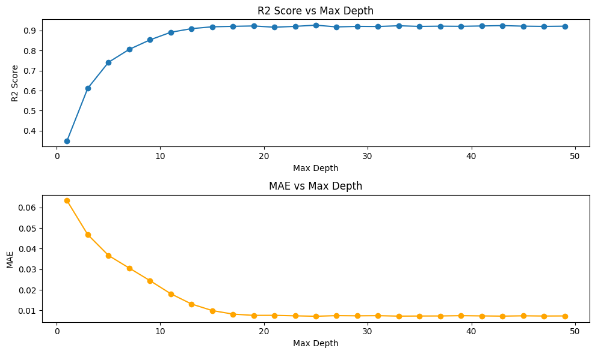
Modeling
Decision Tree
Decision tree parameter: max_depth = 25
Notes:
Dataset split => reach max_depth => Leaf node

Slide 29
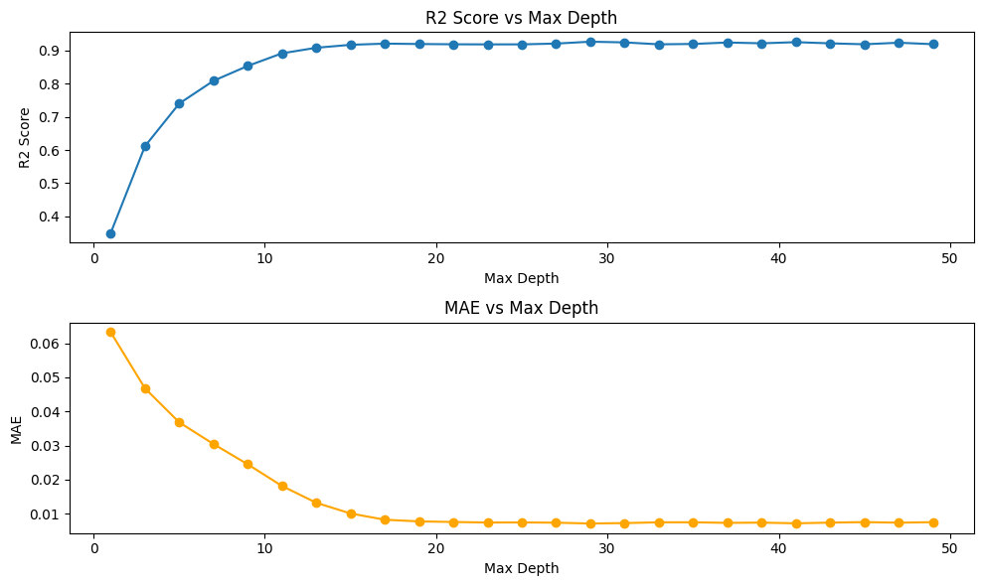
Modeling
Random Forest
Random Forest parameter:
max_depth = 25, n_estimators = 100
Notes:
Bootstrapped sampling => build decision tree

Slide 30
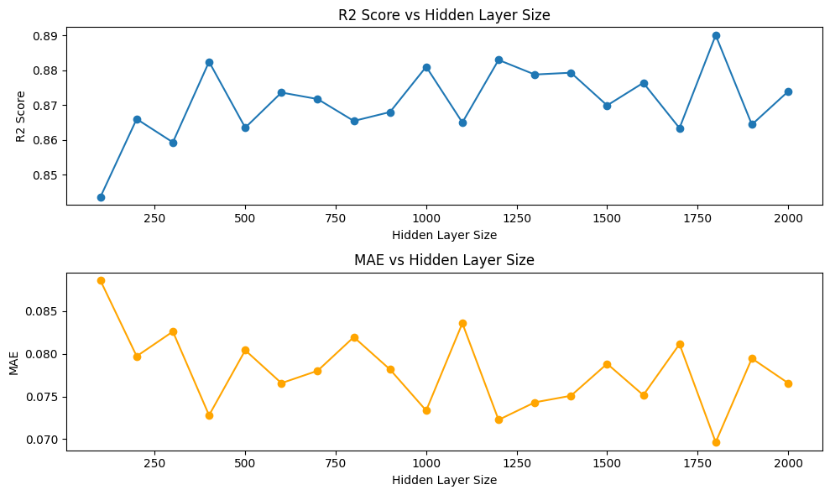
Modeling
MLP
MLP parameter: hidden_layer_size = 1800
Notes:
Interconnected node, or neurons. Include input layer, hidden layer and output layer, hls

Slide 31
Modeling
Ensemble Model
Linear Model
Decision Tree
Ensemble model including all model above, each model will contribute their unique strengths to enhance overall predictive accuracy.
Ensemble Model
Random Forest
KNN
MLP
Notes:
Increasing reliability and predictive accuracy

Slide 32
Experiment and Results
Experiment
One-hot encode
'cpu_amd_3': 0
'cpu_amd_5': 0
'cpu_amd_7': 0
'cpu_amd_9': 0
'cpu_amd_athlon': 0
'cpu_amd_r_series': 0
'cpu_apple': 0
'cpu_intel_celeron': 0
'cpu_intel_i3': 1
'cpu_intel_i5': 0
'cpu_intel_i7': 0
'cpu_intel_i9': 0
'cpu_intel_pentium': 0
'cpu_mediatek_mt8183': 0
'cpu_other': 0
CPU: Intel i3
Notes:
In order to evaluate our models, we have to transform data into a form which can fit models easily.
For categorical features, we will use one-hot encoding to represent these features as binary vectors, it would enable the model to interpret and learn from these attributes more effectively
For example, if we have feature CPU: Intel i3, it would be transformed to 15 features like this. These 15 features are the most common CPU types

Slide 33
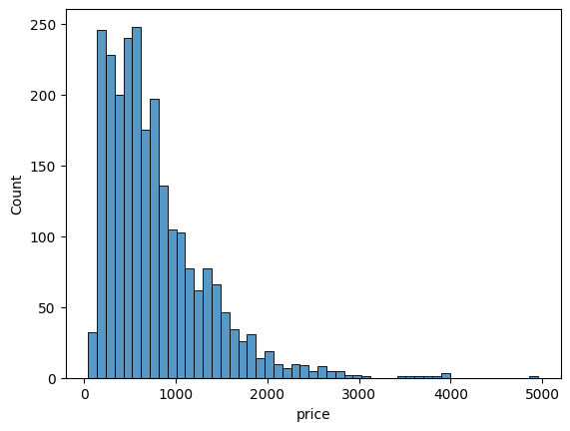
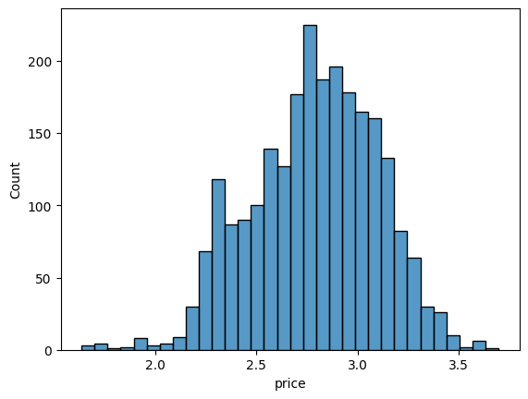
Experiment and Results
Experiment
Log-normalization
Notes:
For numerical features, we use log normalization with logarith base 10.
This can deal with skewed data, which have negative effects on machine learning model. Log normalization helps in addressing this issue by transforming the data to a more symmetrical and approximately normal distribution. Moreover, it also reduce the impact of extreme values. In our data, we some columns which have big value up to millions, so if we use log normalization we can reduce the differences between values in all columns. Then improve our models.
For example, the price of laptop is left skewed, after applying log normalization, it's transformed to approximately normal distribution.

Slide 34
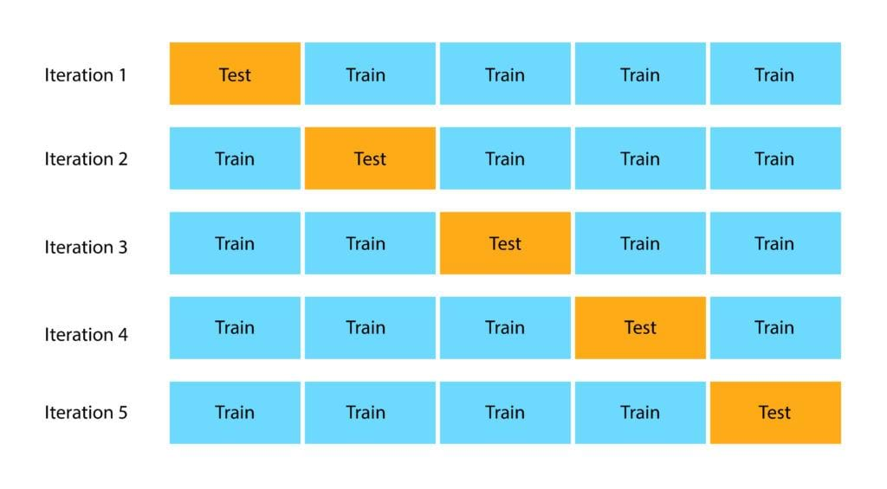
Experiment and Results
Experiment
Cross Validation
Notes:
In order to evaluate model's performance, we utilize a cross-validation approach with 5 folds. Cross-validation involves divide the dataset into multiple subsets, training the model on different combinations of these subsets, and then assessing its performance across remain sets. After applying 5 folds cross validation, we obtain the results:

Slide 35
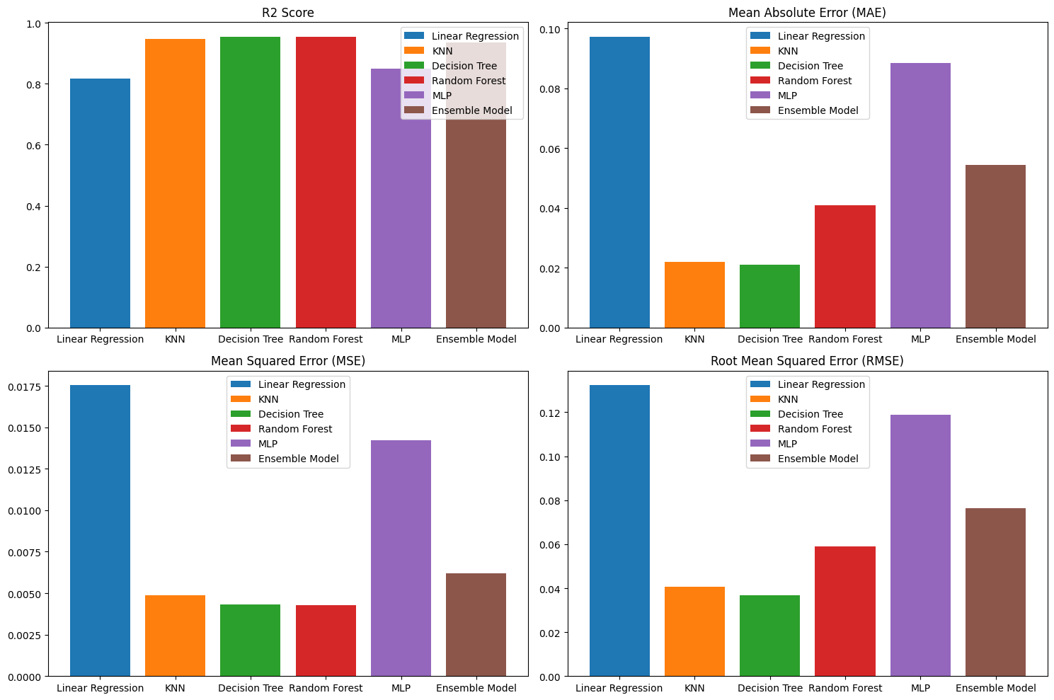
Experiment and Results
Comparative Analysis
Notes:
From the graph we can say that:
KNN, Decision Tree, Random Forest and Ensemble Model have high R2 Score, nearly 0.95
Besides, KNN, Decision Tree and Random Forest have smallest MAE, MSE and RMSE
Hence, we can conclude that those models perform better than others
In the future, we can focus on enhancing the models' applicability and robustness. A specific avenue for future work is real-world validation: We will validate our models on external datasets or in a real-world setting to assess their generalization capabilities and robustness.

Slide 36


